Slide 1

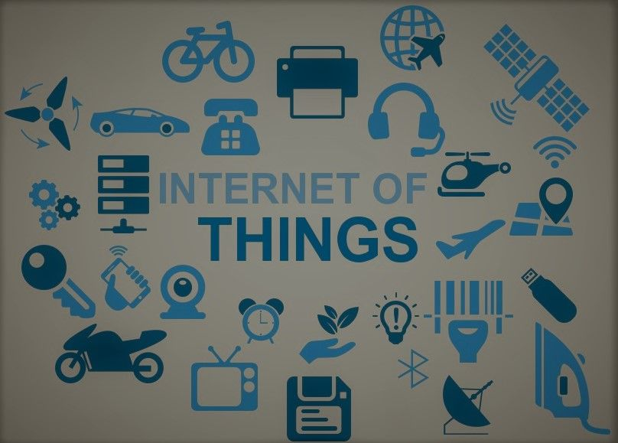
Any sufficiently advanced technology is indistinguishable from magic.

Slide 2

UNIT I
CHAPTER I : The Internet of Things: An Overview
The Flavour of the Internet of Things
The “Internet” of “Things”
The Technology of the Internet of Things
Enchanted Objects

Slide 3
The Flavour of the Internet of Things
Smart Refrigerator
Train schedule Alarm clock
Blinking light –Reminder for medicine intake
Umbrella – weather forecast and many more…

Slide 4
The “Internet” of “Things”
Not a smart phone
communication between devices
Thing – Anything besides traditional computer
Adding Computational Intelligence on device

Slide 5
The Internet of Things
So
What is IoT?
Physical Object (Thing)
+
Computational Intelligence
+
Internet

Slide 6
The Technology of Internet of Things
Powerful and Ubiquitous(Pervasive)
Demand drives down the prices
Not just possible also feasible
Internal and External Communication
Sensors - Microcontroller – Internet

Slide 7
The Technology of Internet of Things
Design methodology - Computers and IoT
Special purpose - Efficient for one task
Inefficient for other task
Internet availability
API

Slide 8
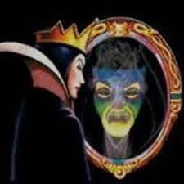
Enchanted Objects
Snow White’s wicked
stepmother
asking
“Mirror Mirror on the wall,
who’s the fairest of all?

Slide 9
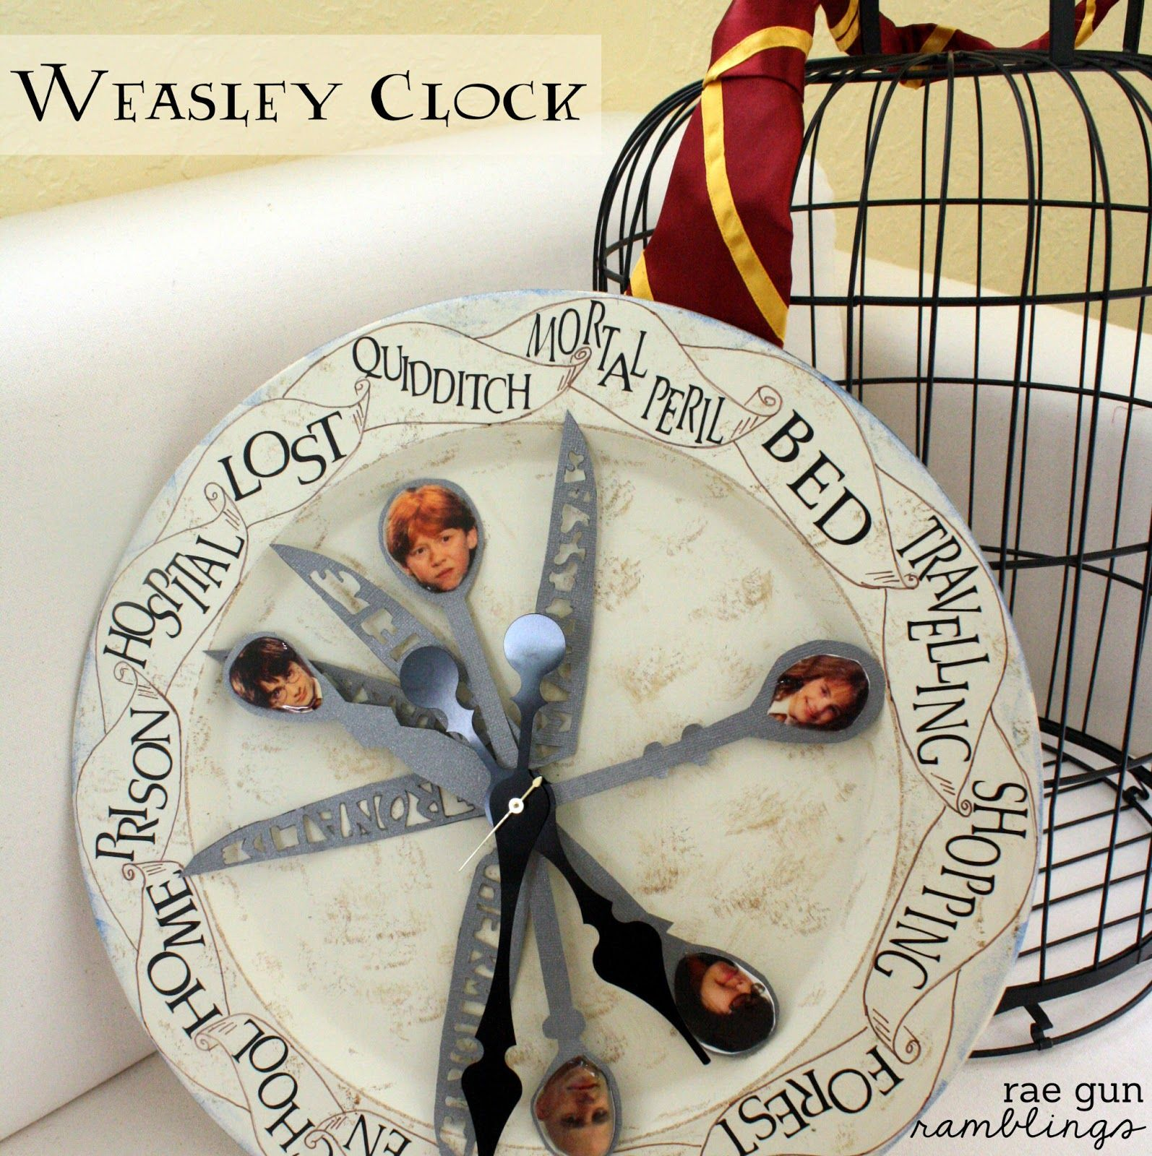
Enchanted Objects
Ron Weasley
Clock shows where his family
members are?

Slide 10
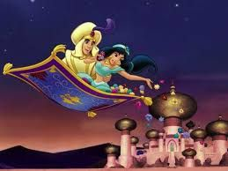


Enchanted Objects
Flying Carpet in Aladdin
Magical shoes in Little Mermaid
Magical fairy wand in Fairy Godmother

Slide 11
UNIT I
CHAPTER 2 : Design Principles for Connected Devices
Calm and Ambient Technology
Magic as Metaphor
Privacy and Security
Web Thinking for connected Devices

Slide 12
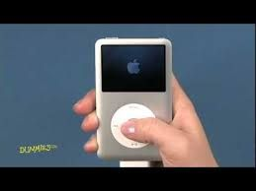
Design Principles for Connected Devices : Calm and Ambient Technology
Calm Technology – No attention,
yet provides information
Good design can aid adaptation
(iPod = scroll wheel + iTunes)
Design next larger context
design without attention seeking cacophony(livewire)

Slide 13
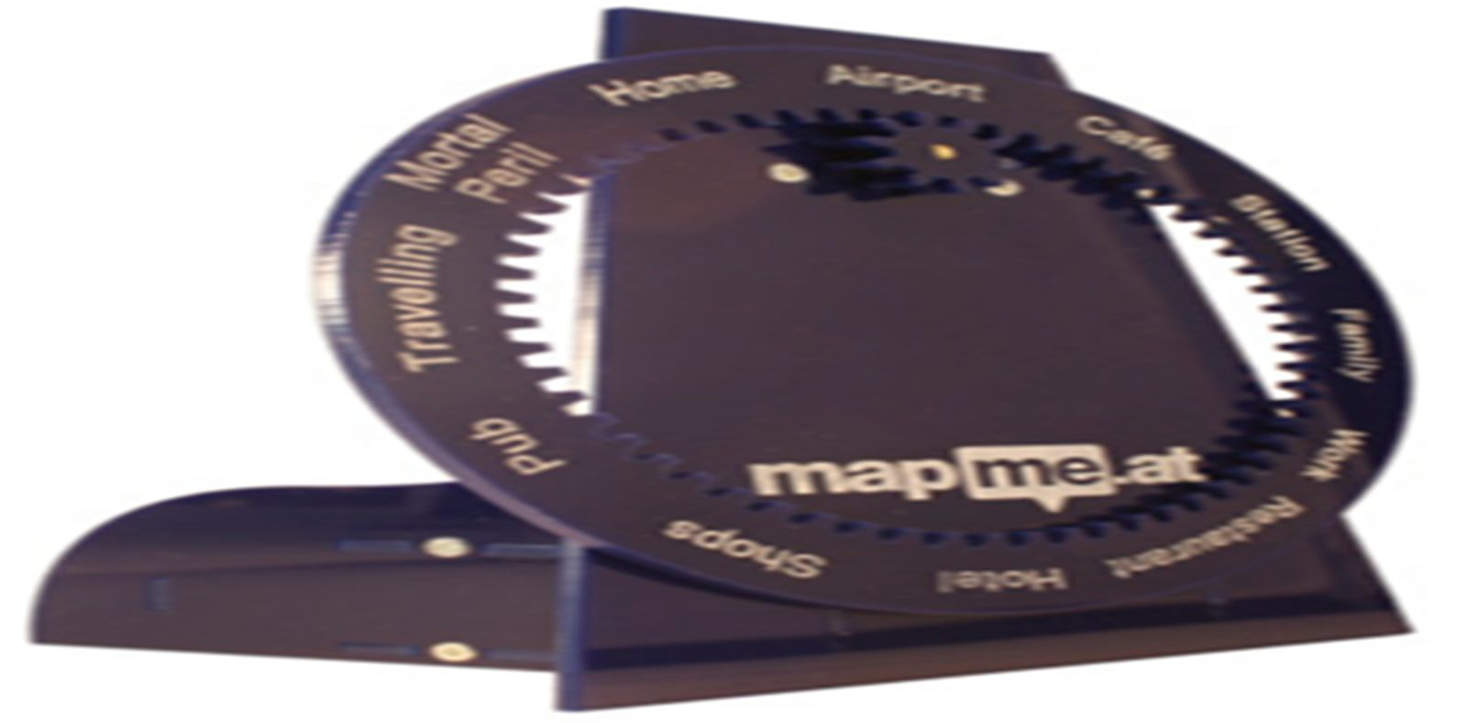
Design Principles for Connected Devices : Magic as Metaphor
Notes:
Metaphor : comparing irrelevantly ex. Mind like a ocean, City like Jungle, etc.

Slide 14
Design Principles for Connected Devices : Magic as Metaphor
Introduce technology to people thru known mode
John McKerrell’s WhereDial – Weasley’s clock
Bathroom mirror to check appointments, traffic and weather information
Sort of magic makes tasks easier and little more fun
Notes:
Metaphor : comparing irrelevantly ex. Mind like a ocean, City like Jungle, etc.

Slide 15
Design Principles for Connected Devices : Privacy and Security
Observation by IoT - Pervasive
Track Card details while IoT device pay bill for you
Health records can be used by Insurance agencies.
Media watching habits to recommend the channels.
Camera recordings can be intrusive
IoT device manufacturer’s permission
Security : Data in Non-Secured way - Hashes
Notes:
Metaphor : comparing irrelevantly ex. Mind like a ocean, City like Jungle, etc.

Slide 16
Design Principles for Connected Devices : Web Thinking of Connected Devices
Small pieces and loosely coupled
Notes:
Metaphor : comparing irrelevantly ex. Mind like a ocean, City like Jungle, etc.

Slide 17
Design Principles for Connected Devices : Web Thinking of Connected Devices
Use existing standards
Notes:
Metaphor : comparing irrelevantly ex. Mind like a ocean, City like Jungle, etc.

Slide 18
Design Principles for Connected Devices : Web Thinking of Connected Devices
Graceful degradation – Backward compatibility
Notes:
Metaphor : comparing irrelevantly ex. Mind like a ocean, City like Jungle, etc.

Slide 19
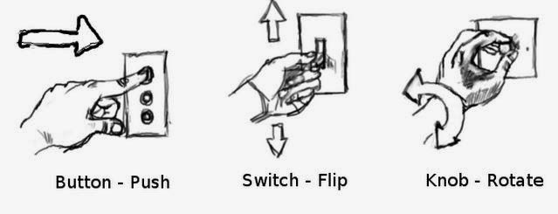
Design Principles for Connected Devices : Web Thinking of Connected Devices
Good Affordances mitigate the risk of adaptation
Cause of poor affordances: Cognitive Dissonance
Solution : Empathy while designing
Notes:
Metaphor : comparing irrelevantly ex. Mind like a ocean, City like Jungle, etc.

Slide 20
Design Principles for Connected Devices : Web Thinking of Connected Devices
Small pieces and loosely coupled
Use existing standards
Graceful degradation – Backward compatibility
Good Affordance mitigate the risk of adaptation
Avoid Cognitive Dissonance
Notes:
Metaphor : comparing irrelevantly ex. Mind like a ocean, City like Jungle, etc.

Slide 21
UNIT I – Chapter 3: Internet Principles
Why is networking needed in IoT?
Notes:
Metaphor : comparing irrelevantly ex. Mind like a ocean, City like Jungle, etc.

Slide 22
UNIT I – Chapter 3: Internet Principles
Why is networking needed in IoT?
To enhance many devices
To access data or computation power outside of the device
Notes:
Metaphor : comparing irrelevantly ex. Mind like a ocean, City like Jungle, etc.

Slide 23
UNIT I – Chapter 3: Internet Principles
Generally Client-Server model
Request Handle request
Response
Single server, one or more clients
Server provides service for clients
Server manages resources
Server responds to clients
Client
Server
Resources
Notes:
Metaphor : comparing irrelevantly ex. Mind like a ocean, City like Jungle, etc.

Slide 24
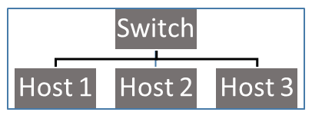
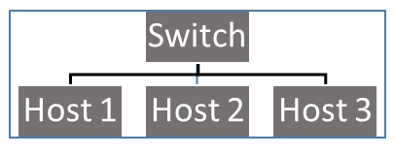
UNIT I – Chapter 3: Internet Principles
Computer Networks
LAN
Spans a building or campus
Smaller LANs connected by Bridge which speaks to LANs
Bridge
Notes:
Metaphor : comparing irrelevantly ex. Mind like a ocean, City like Jungle, etc.

Slide 25
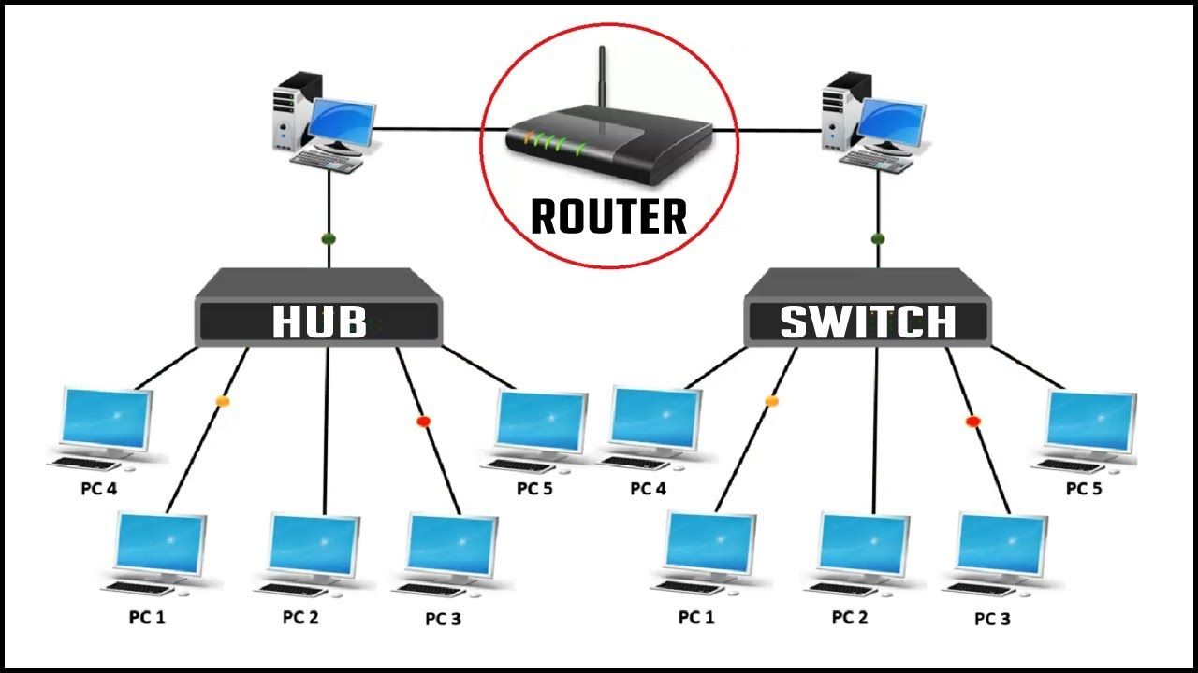

UNIT I – Chapter 3: Internet Principles
WAN (INTERNET)
Multiple LANs connected by routers
IP Address
Network Layer
Notes:
Metaphor : comparing irrelevantly ex. Mind like a ocean, City like Jungle, etc.

Slide 26
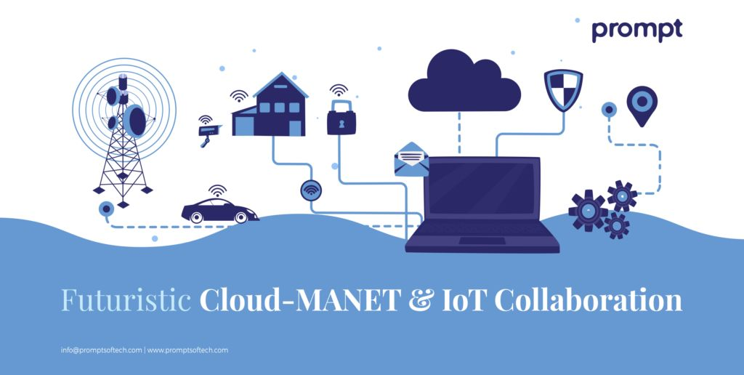
UNIT I – Chapter 3: Internet Principles
MANET (Mobile Ad-hoc Network)
Self-Configurable network of mobile hosts/routers
Access point-Typically short-range
Connected by wireless
Each node plays both roles ie. Of router and host showing autonomous nature
Notes:
Metaphor : comparing irrelevantly ex. Mind like a ocean, City like Jungle, etc.

Slide 27
UNIT I – Chapter 3: Internet Principles
MANET
Energy constrained operation – Battery operated
Bandwidth constrained
Limited security
Notes:
Metaphor : comparing irrelevantly ex. Mind like a ocean, City like Jungle, etc.

Slide 28
UNIT I – Chapter 3: Internet Principles: Internet communication
Internet Protocol
Common communication rules for all networks
ie. Governs how hosts and routers should cooperate when they transfer
data from n/w to n/w
Protocol s/w running on each host and router
Extra data (Header/Footer) with actual message
TCP/IP is a global protocol for internet
Notes:
Metaphor : comparing irrelevantly ex. Mind like a ocean, City like Jungle, etc.

Slide 29
UNIT I – Chapter 3: Internet Principles: Internet communication
What does an Internet Protocol do?
Provides a naming scheme
Provides delivery mechanism
Defines header
Managing networking tasks to transmit and receive data
Protocol stack
Notes:
Metaphor : comparing irrelevantly ex. Mind like a ocean, City like Jungle, etc.

Slide 30
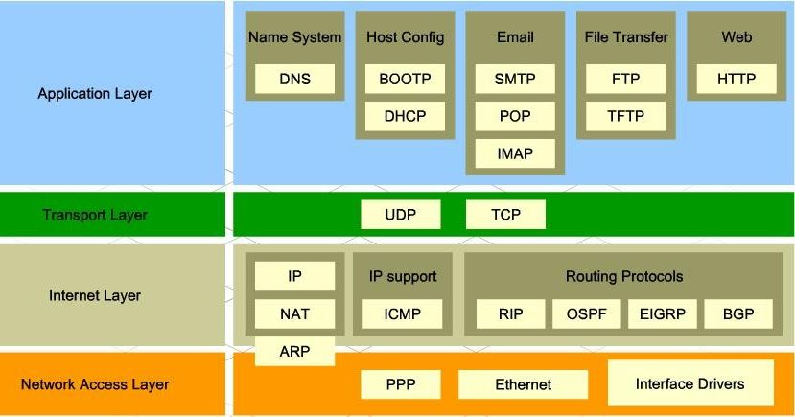
UNIT I – Chapter 3: Internet Principles: Internet communication
Protocol stack
Notes:
Metaphor : comparing irrelevantly ex. Mind like a ocean, City like Jungle, etc.

Slide 31
UNIT I – Chapter 3: Internet Principles: Internet communication
What does an Internet Protocol do?
Provides a naming scheme
Provides delivery mechanism
Defines header
Managing networking tasks to transmit and receive data
Protocol stack
Notes:
Metaphor : comparing irrelevantly ex. Mind like a ocean, City like Jungle, etc.

